Slide 1
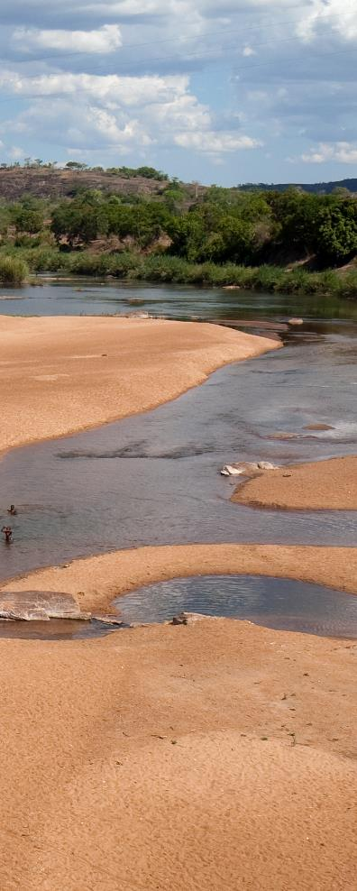
Local ownership of water management programmes: synergy with environmental and social assessment
Summary of two online sessions, cases and Q&A, including references and video’s
Lessons learnt Mali
the Sourou river
valley case
Introduction
The role of the NCEA
Conclusions
1st session
Do’s and don’ts - drawing from practice
Lessons learnt Niger
the Niger river
valley case
The role of EA
in creating local ownership
Lessons learnt Bangladesh
the Brahmaputra case
More information

Slide 2
“Lack of local ownership and collaboration are key bottlenecks for the development of water programmes.”
Introduction
Dutch embassies are developing their new strategic plans. On the 18th and 19th of January 2022, the Water Support Programme (executed by the Netherlands Water Partnership (NWP) and the Netherlands Enterprise Agency), the Netherlands Commission for Environmental assessment (NCEA) and the Directorate-General International Cooperation (DGIS) of the Dutch Ministry of Foreign Affairs organised two online meetings with heads of development cooperation from a selection of Dutch embassies, as well as water experts and NGOs involved in the landscape approach.
The goal of the meetings was to further explore the link between embassy programmes, local ownership and EA.
René van Hell (director DGIS / Inclusive Green Growth) noted two long-time bottlenecks:
Aid-receiving countries often have difficulty taking ownership of development programmes.
Lack of collaboration between development authorities, and authorities responsible for other SDGs like agriculture, infrastructure, education, and rule of law.
On January 18th, southern partners from Mali, Niger and Bangladesh were invited to share their experiences. On the 19th of January, heads of development cooperation discussed what these experiences mean to them.
Their main conclusion was that we need to keep looking for ways to connect programmes to local ownership, and where possible find synergy with the NCEA. This is a joint agenda for embassies, water experts, DGIS and the NCEA.
Contents
What is environmental assessment?
In just about every country in the world, it is required by law to conduct an environmental assessment before major commitments are made. Environmental assessment can be conducted at two levels of decision making:
Decision making on projects, such as a dam, motorway, airport or windpark. This is called Environmental and Social Impact Assessment (ESIA).
Decision making on plans, programmes or policies, such as a land use plan or an energy plan. This is called Strategic Environmental (and Social) Assessment (SEA or SESA).
For more see the NCEA’s website.
Introduction
Conclusions 1st session
The role of EA in
creating local ownership
The role of the NCEA
Do’s and don’ts -
drawing from practice
Lessons learnt Mali
the Sourou river valley case
Lessons learnt Niger
the Niger river valley case
Lessons learnt Bangladesh
the Brahmaputra case
More information
2

Slide 3
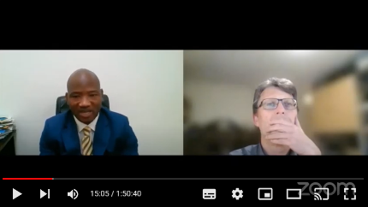
“EA can be a bridge between informal local processes and formal government planning, enabling local communities to co-decide.”
Conclusions of the first session
Karin Roelofs (head of the DGIS/IGG water cluster) summarised the take-aways on the role of EA and the NCEA as follows:
From the start of a planning process, local communities must be involved in the environmental assessment process and decision-making, as in Mali. If not, it will have to be corrected later, as in Bangladesh. The environmental assessment process also lends itself well to involve local communities early.
Although governments have laid down environmental assessment in legislation, its application in practice is still limited. All three cases concerned first applications. And the broad role of NCEA was appreciated in this: review, coaching and capacity building in the process.
Environmental assessment ensures that the governance and institutional basis and cooperation of government agencies are improved. Also, as in Niger, gaining political backing is crucial; it touches on power relations.
At the start of the planning process, the procedural and decision-making steps should be made transparent. Including the local environmental assessment requirements. The strength of this process is that it can bridge the gap between informal local processes and formal government planning, so that local stakeholders can participate in decision-making.
An integral plan with local ownership can be presented to donors and in Mali this was called a new form of donor coordination. This is a recipe for reducing project fragmentation and stimulating donor collaboration.
One of our most important challenges in the coming years is to give substance to strengthening Locally Led Adaptation. After all, in Glasgow, the Netherlands and several other governments and organizations have endorsed the principles for Locally Led Adaptation.
We saw that we could use the environmental assessment process and the support of the NCEA in contributing to the NDCs, Nationally Determined Contributions. Locally supported plans can provide an effective approach to attracting climate finance.
Contents
Introduction
Conclusions 1st session
The role of EA in
creating local ownership
The role of the NCEA
Do’s and don’ts -
drawing from practice
Lessons learnt Mali
the Sourou river valley case
Lessons learnt Niger
the Niger river valley case
Video recording of the January 18th session
Lessons learnt Bangladesh
the Brahmaputra case
More information
3

Slide 4
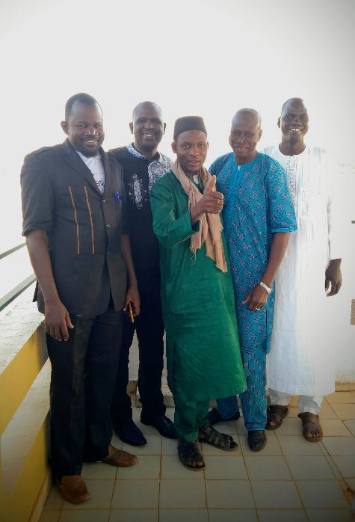
“The strategic EA enabled the Sourou area authority to take the lead in negotiations on all potentially sustainable developments with all ethnic groups and with all relevant ministries.”
The role of EA in creating local ownership
Different responsible government agencies may need to work together before they can credibly engage with NGOs, the private sector and the wider public. In many countries, this is not common practice. These countries may benefit from donor-funded support with such collaboration processes. For the sake of local ownership, embassies or donors in general - or their consultants - should not be dictating what the outcomes of these processes must be.
Local governments should legitimately represent the different stakeholder groups affected by their decisions. They should be able to autonomously decide the direction of their country’s development. Donors may provide neutral support to such multi-stakeholder processes. That requires specific approaches, much like mediations.
EA is a process that can help in these conditions, as it is based on a legal procedure enhancing ownership, which is applicable in all countries worldwide.
The EA process identifies one or more government authorities to be formal owner of a planning decision. The EA procedure increases formal legitimacy of their decisions, in whatever sector. It does so by demanding that the government opens up to all stakeholders in the early phases of planning, and requiring that it is responsive to the public’s points of view (on water, environment, climate or social issues).
This early transparency makes it more attractive to these authorities to actively engage with affected groups even earlier, although it is not obliged to do so, as it may not be feasible to them to engage with all groups to the same extent from the start.
Contents
Introduction
Conclusions 1st session
The role of EA in
creating local ownership
The role of the NCEA
Do’s and don’ts -
drawing from practice
Lessons learnt Mali
the Sourou river valley case
Lessons learnt Niger
the Niger river valley case
Lessons learnt Bangladesh
the Brahmaputra case
More information
Continue – The role of EA in local ownership
4

Slide 5
The EA process is in some ways similar to approaches like IWRM and the Landscape Approach, but these processes are not necessarily embedded in local, formal procedures, and may not have the same in-roads to legitimacy of decision-making as EA. Where the country’s own legal and institutional context has gaps, these may be filled with additional but formal ad-hoc arrangements (as was done in the Mali case).
Another relevant characteristic of EA is that it does not presuppose specific planning outcomes. And when donors support an EA process, that support can concentrate on multi-stakeholder planning and be neutral in terms of the planning outcomes the stakeholders and the southern decision-makers may choose to pursue. This also enhances ownership.
During subsequent implementation, decisions may have to be elaborated in more detail or even adjusted: also in the implementation phase therefore, support to the legitimate decision-maker may need to be separate from doing or supporting the implementation of their decisions (this is an issue in the Mali case).
We are only beginning to understand, with the above in mind, how to secure local ownership in embassies’ definition of programmes, their support to programmes, and sometimes their tendering. But clearly this requires a good understanding of the context in a specific situation. For example, will local ownership be stronger when national ministries are targeted first, or should a donor start with support to local governments (e.g. on provincial or community level). And how to include different groups in the population in a balanced way? This all depends on the circumstances: the multi-actor context. How do embassies analyse that context, and what strategic choices are being made in the support arrangements? What may be the role of consultants in this? What difference can applying EA make? And how can the NCEA assist?
Contents
Introduction
Conclusions 1st session
The role of EA in
creating local ownership
The role of the NCEA
Do’s and don’ts -
drawing from practice
Lessons learnt Mali
the Sourou river valley case
Lessons learnt Niger
the Niger river valley case
Lessons learnt Bangladesh
the Brahmaputra case
More information
5

Slide 6
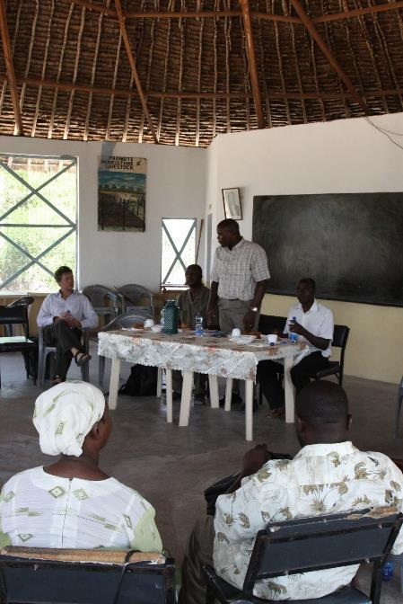
“The NCEA’s presence gives us the confidence we need to engage in inclusive planning.” (One of the NCEAs southern partners)
“Embassies should focus on the political aspects during programme implementation.”
The role of the NCEA
EA’s effectiveness depends on inclusive multi-actor processes. In the context of an EA procedure, the NCEA may therefore support the organisation of such processes, on top of doing more ‘technical’ reviews.
Before it decides to support a partner, the NCEA always considers their commitment, i.e., their willingness to truly engage in inclusive processes. If a partner’s capacity is insufficient, but their commitment is strong, the NCEA may support them as they learn-on-the-job. Without taking over anyone’s role in the EA procedure (different authorities, NGOs, businesses, the public, as well as consultants), the NCEA can neutrally advise the actors, as a group, about their process. It can help its southern partners to organise their assessment process, and how it is linked to decision-making, in an inclusive and technically sound way. For example, by coaching the process facilitator.
In this way, the NCEA can give the partner they work with more confidence that transparency will pay off. That it will manifest as improved support for their decisions, and as improved bankability of subsequent proposals for implementation. This point was made in the cases presented by southern partners from Mali, Niger and Bangladesh.
The following points were made specifically about the synergy between embassies and the NCEA:
Dutch embassies can help define programmes based on local ownership, by making assessments of the political and institutional context, managing the political aspects and making links with other donors.
Contents
Introduction
Conclusions 1st session
The role of EA in
creating local ownership
The role of the NCEA
Do’s and don’ts -
drawing from practice
Lessons learnt Mali
the Sourou river valley case
Lessons learnt Niger
the Niger river valley case
Lessons learnt Bangladesh
the Brahmaputra case
More information
Continue - the role of the NCEA
6

Slide 7
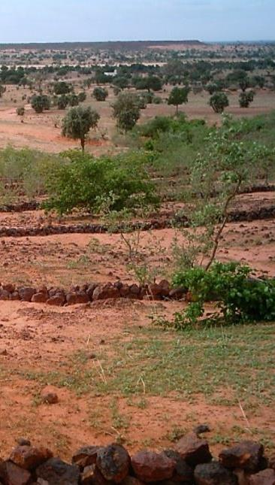
”Synergies make ownership happen: Southern partner – donor funded consultant – NCEA – embassy.”
The NCEA’s mandate and resources are not always sufficient to support multi-stakeholder processes on a daily basis or to manage funds to that end. Government agencies may need embassy (or another donor’s) support to organise their assessment and decision-making process, for example by a hiring a consultant as process facilitator, like the embassy has done in the Mali case. The NCEA can still play its independent role. In in Mali, the Dutch embassy facilitated synergy between VNGi (Sankarani case), Enabel (Nara case, still in its exploration phase), with the NCEA as technical partner.
A threefold synergy can thus emerge: southern partner (owning inclusive planning decisions) – embassy funded consultant (day-to-day support of the assessment and decision-making process without taking over ownership) – NCEA (a more independent long-term partner to the authorities).
Planning decisions may include many costly actions, and the implementation of these actions may depend again on other donors. Like in the Mali Sourou case, the planning authorities defined a basket of actions, using their plan to invite donors willing to financially support specific actions. Here again, the embassy may facilitate this synergy with other donors.
Contents
Introduction
Conclusions 1st session
The role of EA in
creating local ownership
The role of the NCEA
Do’s and don’ts -
drawing from practice
Lessons learnt Mali
the Sourou river valley case
Lessons learnt Niger
the Niger river valley case
Lessons learnt Bangladesh
the Brahmaputra case
More information
7

Slide 8
“Environmental and Social Assessment is an effective coordinating framework for multi-actor processes.” (a head of development cooperation)
Do’s and don’ts – drawing on practice
At the second meeting the Heads of Development discussed their practical experience and drew out a number of do’s and don’ts.
NCEA has a unique position as supporter of processes
Few organisations are like the NCEA: dedicated to process support as the effectiveness of EA depends not only on technical reviews, but also on complex stakeholder processes required to make technical knowledge relevant to impactful decision-making. It has resources to invest in relationships required to start such processes.
Tip: Look for synergy with the NCEA where you need to line-up several interdependent stakeholders of important SDGs, even if this is at decentral level (embassies may operate less at that level).
Tip: Make use of the NCEA’s ‘patience’ to allow enough time for their partners to set their own pace of decision-making, needed for ownership.
Observation: the NCEA does not fund their partners’ work, making it easier to verify their ownership. Also, it will not continue cooperation with a partner if this ownership is disappointing.
Compartmentalisation is an issue
Many programmes are developed with one lead agency, and others are not involved until key decisions have already been made. This is likely to create either resistance in the implementation phase, or a more narrow contribution to SDGs. Multi-actor processes are difficult to manage. A process like EA provides an incentive to do that, and a neutral facilitator may give the actors confidence that it is possible.
Tip: don’t try to do everything yourself. The embassy does not have the sole responsibility for the realisation of multi actor processes; this also is a responsibility for the contractors. Embassy-focus should be on the political aspects, not on the execution.
Tip: involve NCEA from the start.
Observation: compartmentalisation is an issue within Dutch ministries too.
Contents
Introduction
Conclusions 1st session
The role of EA in
creating local ownership
The role of the NCEA
Do’s and don’ts -
drawing from practice
Lessons learnt Mali
the Sourou river valley case
Lessons learnt Niger
the Niger river valley case
Lessons learnt Bangladesh
the Brahmaputra case
More information
Continue - Do’s and don’ts
8

Slide 9
“Organising multi actor process is a ‘contest in patience.“
“In multi-actor processes it should be agreed by all parties which Southern authority is in the driver’s seat to coordinate planning.”
Too much ownership can be an issue too
It is common that too many parties claim ownership, all endorsing different agendas rather than following a joint one. If everyone is responsible, no one takes responsibility. Think of the often occurring conflicts between pastoralists and nomads, arable farming and livestock farmers, etc. Resolving this complexity will take time. It’s a ‘contest in patience’. Joint ownership - i.e., collaboration – can only develop one step at a time and by trial and error.
Tip: particularly in multi actor processes it should be clear who is in the drivers’ seat, and that this entity is accepted by all actors.
Observation: there may be tension between the amount of time it takes to organise a multi actor process and the need to deliver short term (economic) results. However, both can run in parallel serving the same population with short term ‘no regret’ actions that benefit all groups.
Observation: It helps if a neutral mediator and reviewer like the NCEA is present in the long term to help the collaboration back on track after it hits a hurdle.
Strategically engage other donors
It is important to include other (financial) donors in the development and implementation of programmes. However, don’t do this too soon. First reassure yourself that they will not ‘hijack’ ownership. While the Dutch Diamond approach builds on policy dialogues to tackle issues, not all donors may share this vision. Particularly in the case of ‘big’ donors there is a risk that they will take over the process using more classical (centralised) approaches.
Tip: being the first to finance helps in firmly establishing a Dutch approach to planning.
Observation: it is not easy to coordinate donor actions. In a locally owned plan, created in a multi stakeholder process, it is easier to coordinate all SDGs and interests. Donors aiming at specific SDGs then can take their pick.
Observation: the Dutch vision on water programming is valuable, but the local vision on development should be leading, or it will not work.
Contents
Introduction
Conclusions 1st session
The role of EA in
creating local ownership
The role of the NCEA
Do’s and don’ts -
drawing from practice
Lessons learnt Mali
the Sourou river valley case
Lessons learnt Niger
the Niger river valley case
Lessons learnt Bangladesh
the Brahmaputra case
More information
9

Slide 10
Lessons learnt in Mali – the Sourou river valley case
The Sourou program started out as a classical programme, focused on technical means to increase rice production. However, because of the complexity of the program and the risk of conflict because of incompatible stakeholder demands, the focus was shifted to a multi user land use plan. Strategic Environmental Assessment was chosen as the coordinating legal framework for organising this process.
The NCEA supported this process; it advised the local authorities to join-up in a formal : the Intercollectivité du Sourou (ICS). The approach was successful and boosted both confidence and sense of ownership among the 29 communities involved. Lessons were learned on the importance of understanding the institutional and social context, on the use of SEA to structure the multi-stakeholder and multi-level decision-making process, on the link with decentralisation, on the link between general development planning and water management, on the link with climate finance and on the link between local authorities and donors.
For more information please contact Sibout Nooteboom (NCEA) or the NCEA website, including an interactive evaluation. There is also a policy brief on the site of institute Clingendael.
Contents
Introduction
Conclusions 1st session
The role of EA in
creating local ownership
This short film was recorded on the day the ICS adopted the Sourou sustainable development plan.
The role of the NCEA
Do’s and don’ts -
drawing from practice
Lessons learnt Mali
the Sourou river valley case
Lessons learnt Niger
the Niger river valley case
Lessons learnt Bangladesh
the Brahmaputra case
Here you can stream the interview of the 18th of January 2022 with Dr. Drissa Doumbia (at the time the NDC coordinator at the climate finance focal point of Mali).
More information
10

Slide 11
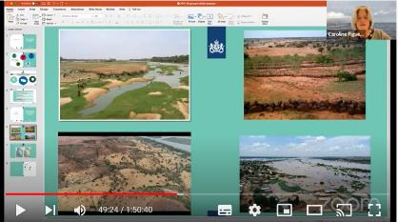
Lessons learnt Niger: the Niger river valley case
The Niger valley in Niger is a poor area with increasing conflicts about natural resources. The Dutch embassy in Niamey is discussing with their partner how to prepare a locally owned programme to reduce the root causes of conflict. Key partner is the ministry that, is amongst other things, responsible for water management and reforestation. Once ready, the programme is expected to be supported through Dutch private sector funding, so the RVO is involved in the early stages. As the plan will require an EA, the NCEA is also involved already. Lessons are emerging for example relating to (i) the link between the role of this ministry and that of other ministries that also having responsibilities related to natural resources management in the same area, and are funded by other donors, (ii) how these different programmes will interact ‘on the ground’ where populations will want to make their own development decisions, and (iii) how to structure multi-sector and multilevel decision-making on the use of natural resources to enable technical analysis in the framework of EA that is meaningful to these decisions, (iv) how to organise the knowledge infrastructure to the benefit of such EA.
For information please contact Stephen Teeuwen (NCEA) or see the NCEA site.
Contents
Introduction
Conclusions 1st session
The role of EA in
creating local ownership
Here you can stream the Niger case of the 18th of January 2022
The role of the NCEA
Do’s and don’ts -
drawing from practice
Lessons learnt Mali
the Sourou river valley case
Lessons learnt Niger
the Niger river valley case
Lessons learnt Bangladesh
the Brahmaputra case
More information
11

Slide 12
Lessons learnt Bangladesh: the Brahmaputra case
Bangladesh is implementing a 25-year river stabilisation program for the Jamuna-Padma-Lower Meghna river system. The programme is divided in five phases of five years each. In the first phase a River Stabilisation plan was made supported by an EA and the NCEA. This first phase resulted in some important lessons that will be applied in the second phase in which the plan will be adjusted with the help of a new version of the EA. Important shifts are:
From the Water Development Board originally being solely responsible for the plan, to multiple parties being responsible now.
From an originally very narrow technical approach to an integral multi sector approach.
From a focus on ‘joint decision making’ first to ‘joint plan designing’ now.
The plan has a huge resettlement challenge; originally this was not on the radar. It is now being discussed to apply SESA in the implementation of regional specific plans that have been identified in the Netherlands supported Bangladesh Delta Plan 2100.
For more information please contact
Arend Kolhoff (NCEA) or the NCEA site.
Contents
Introduction
Conclusions 1st session
The role of EA in
creating local ownership
Here you can stream the Bangladesh case of the
18th of January 2022
The role of the NCEA
Do’s and don’ts -
drawing from practice
Lessons learnt Mali
the Sourou river valley case
Lessons learnt Niger
the Niger river valley case
Lessons learnt Bangladesh
the Brahmaputra case
More information
12

Slide 13
More information
For more information, please contact:
Water Support Programme
Netherlands Water Partnership : Sabrina Kraaijenbrink-Doetjes s.doetjes@nwp.nl
RVO – Fernanda van der Velde - fernanda.vandervelde@rvo.nl
DGIS
Omer van Renterghem - omer-van.renterghem@minbuza.nl
NCEA
Bobbi Schijf - bschijf@eia.nl
Sibout Nooteboom - snooteboom@eia.nl
Contents
Introduction
Conclusions 1st session
The role of EA in
creating local ownership
The role of the NCEA
Do’s and don’ts -
drawing from practice
Lessons learnt Mali
the Sourou river valley case
Lessons learnt Niger
the Niger river valley case
Lessons learnt Bangladesh
the Brahmaputra case
More information
13

